Slide 1


Capital Structure, an investors view
Diomides Mavroyiannis
Email: Diomides.Mavroyiannis@schumanassociates.com
+33 695669809
March 2021
Copyright © 2021 Schuman Associates

Slide 2
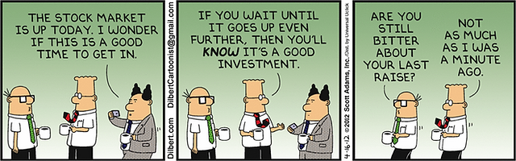

Investors want to measure company value
They want to know where they should put their money
What are investors measuring?
Copyright © 2021 Schuman Associates

Slide 3
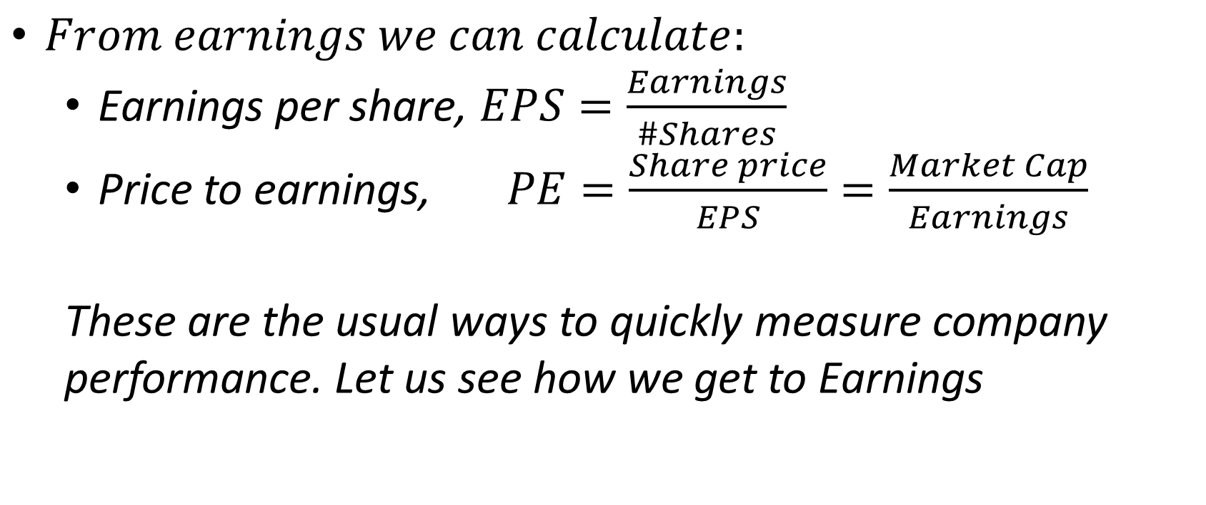
$From earnings we can calculate:$
Earnings per share, $EPS=\frac{Earnings}{\#Shares}$
Price to earnings, $PE=\frac{Share price}{EPS}=\frac{Market Cap}{Earnings}$
These are the usual ways to quickly measure company performance. Let us see how we get to Earnings
The usual metrics
Copyright © 2021 Schuman Associates

Slide 4
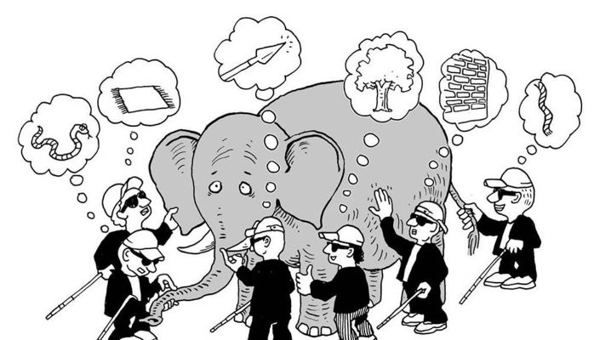
Problem: Each blind person uses the same measurement(touching) and gets different results
Blind men and the elephant
Copyright © 2021 Schuman Associates

Slide 5
What makes a good instrument
Reliable: Has a good chance to succeed
Consistent: Gives the same result in the same situation
Sensitive: If the target changes, the result changes
Invariant to other dimensions: Is not affected by variation in things other than the target
Noisy Instrument
Copyright © 2021 Schuman Associates

Slide 6
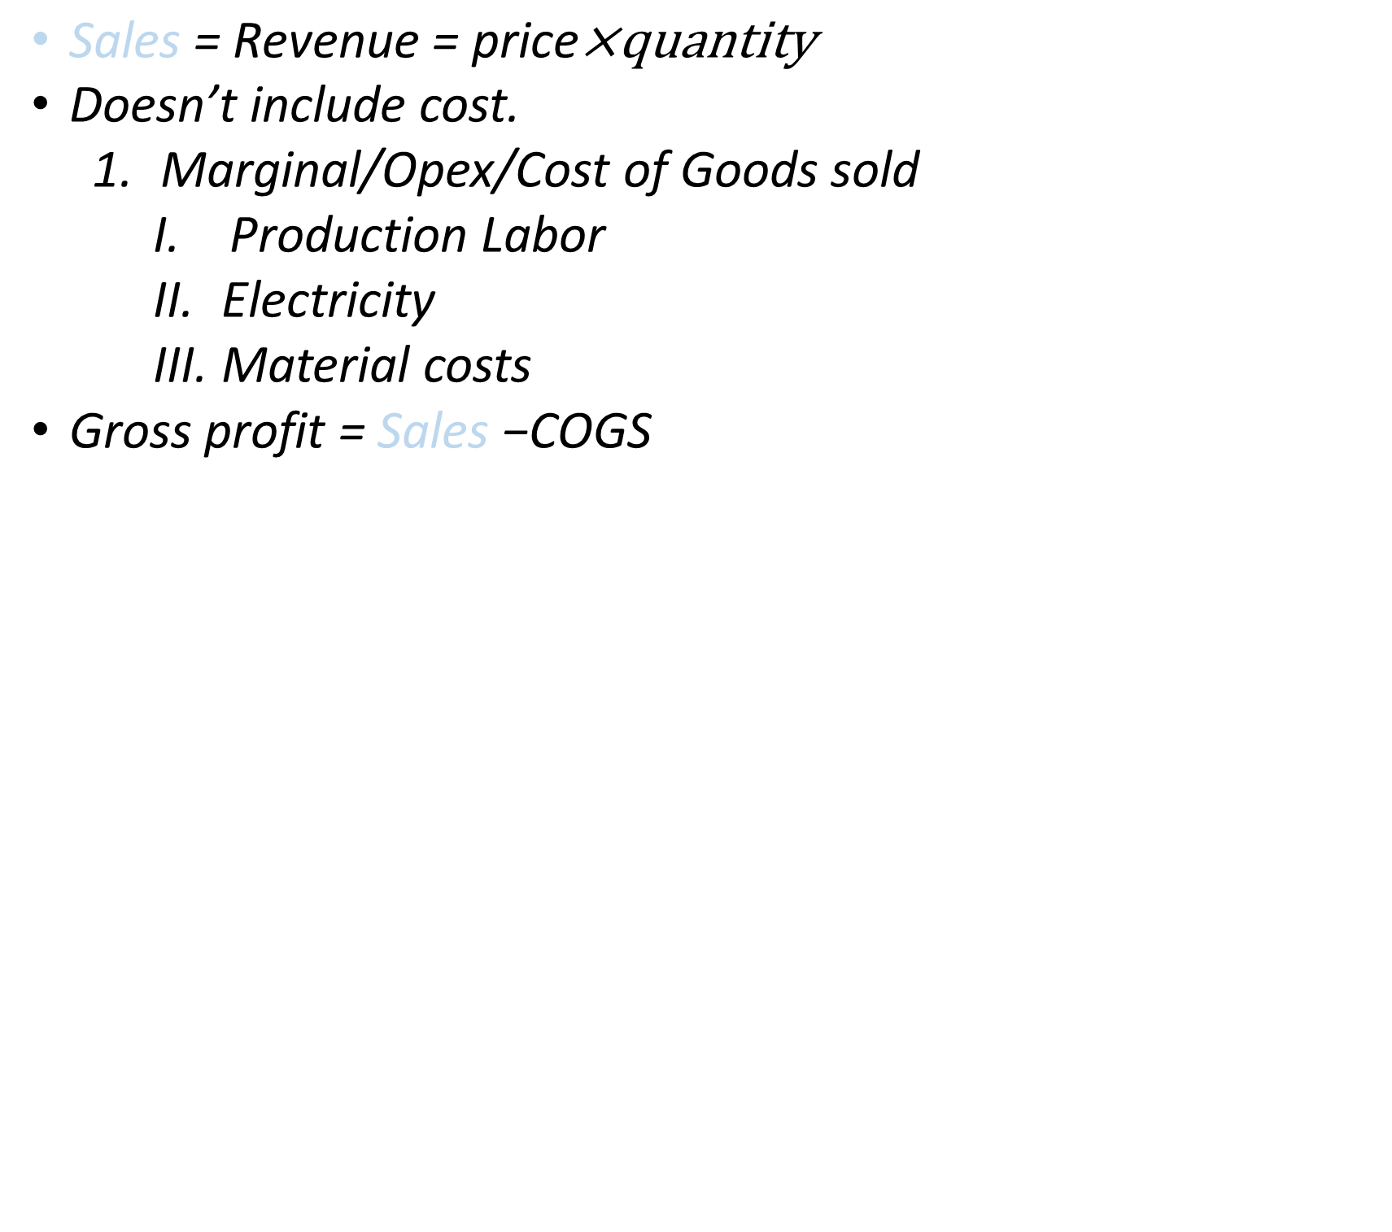
$\text{Sales}\text{ = }\text{Revenue}\text{ = }\text{price}\text{×}\text{quantity}$
Doesn’t include cost.
Marginal/Opex/Cost of Goods sold
Production Labor
Electricity
Material costs
$\text{Gross} \text{profit}\text{ = }\text{S}\text{ales}\text{ −}\text{COGS}$
What are investors measuring? (1)
Copyright © 2021 Schuman Associates

Slide 7
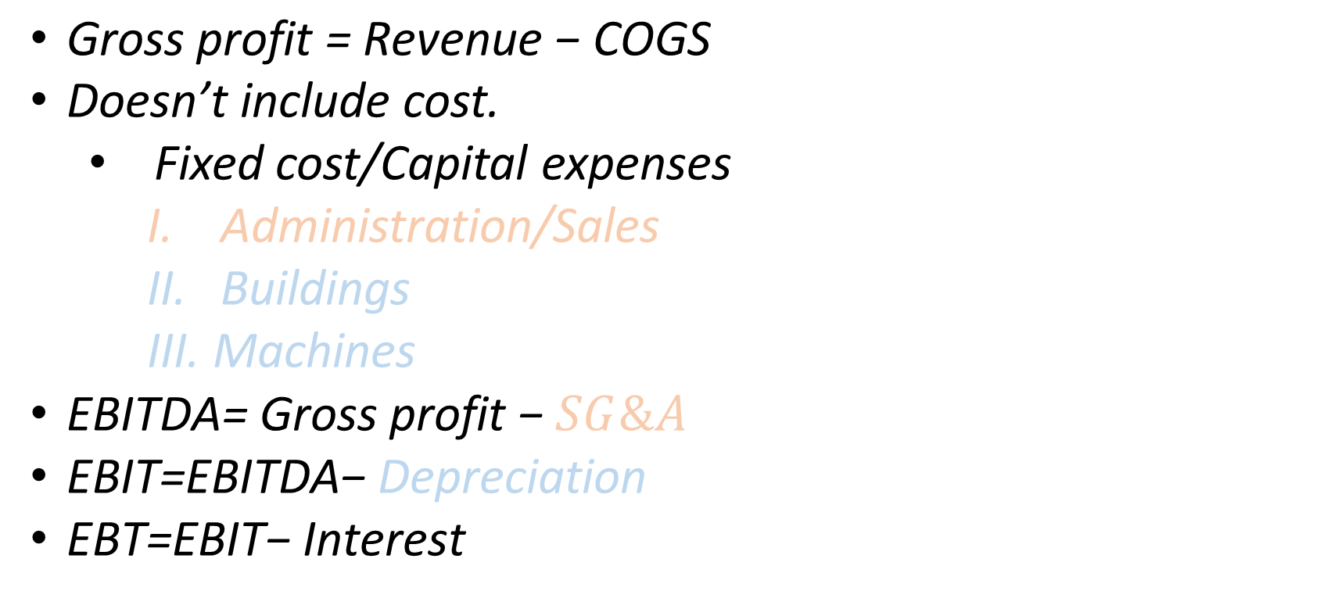
$\text{Gross} \text{profit} \text{= }\text{R}\text{evenue}\text{ − }\text{COGS}$
Doesn’t include cost.
Fixed cost/Capital expenses
Administration/Sales
Buildings
Machines
$\text{EBITDA}\text{=} \text{Gross} \text{profit}\text{ − }SG\&A$
$\text{EBIT}\text{=}\text{EBITDA}\text{− }\text{Depreciation}$
$\text{EBT}\text{=}\text{EBIT}\text{− }\text{Interest}$
What are investors measuring? (2)
Copyright © 2021 Schuman Associates

Slide 8
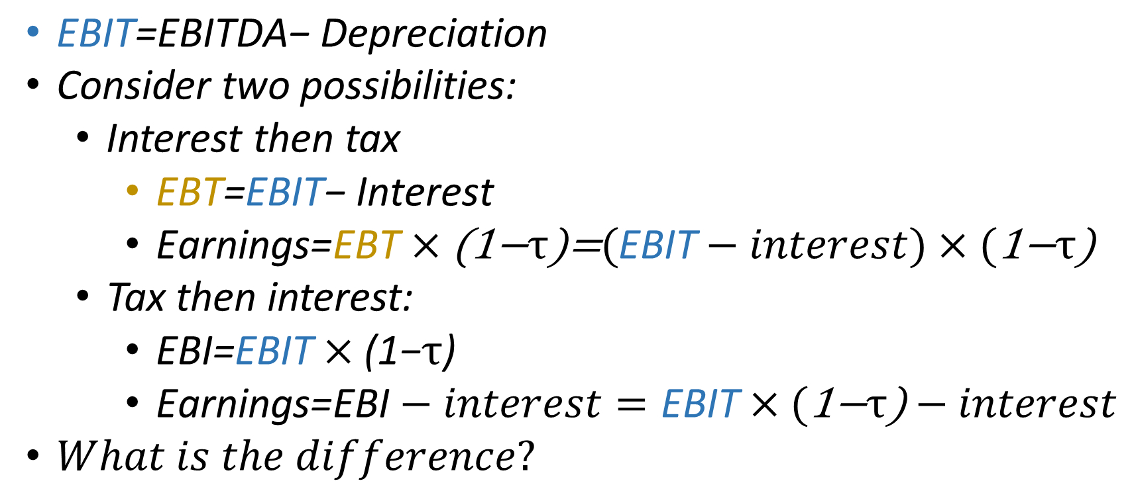
$\text{EBIT}\text{=}\text{EBITDA}\text{− }\text{Depreciation}$
Consider two possibilities:
Interest then tax
$\text{EBT}\text{=}\text{EBIT}\text{− }\text{Interest}$
$\text{Earnings}\text{=}\text{EBT}×\text{(1−}τ\text{)}\text{=}(\text{EBIT}−interest)×(\text{1−}τ\text{)}$
Tax then interest:
$\text{EBI}\text{=}\text{EBIT}×\text{(1−}τ\text{)}$
$\text{Earnings}\text{=}\text{EBI}−interest=\text{EBIT}×(\text{1−}τ\text{)}−interest$
$What is the difference?$
What are investors measuring? (3)
Copyright © 2021 Schuman Associates

Slide 9
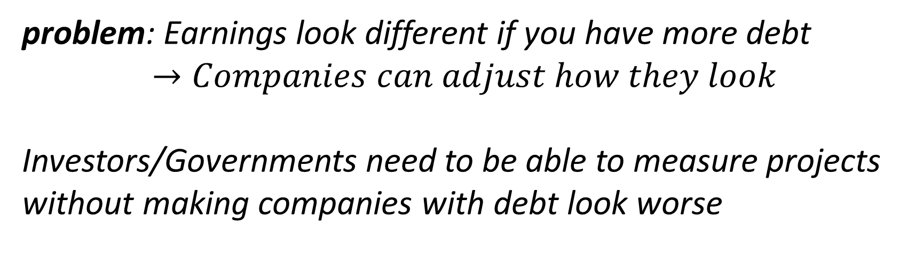
problem: Earnings look different if you have more debt
$$→Companies can adjust how they look$$
Investors/Governments need to be able to measure projects without making companies with debt look worse
What are investors measuring? (4)
Copyright © 2021 Schuman Associates

Slide 10
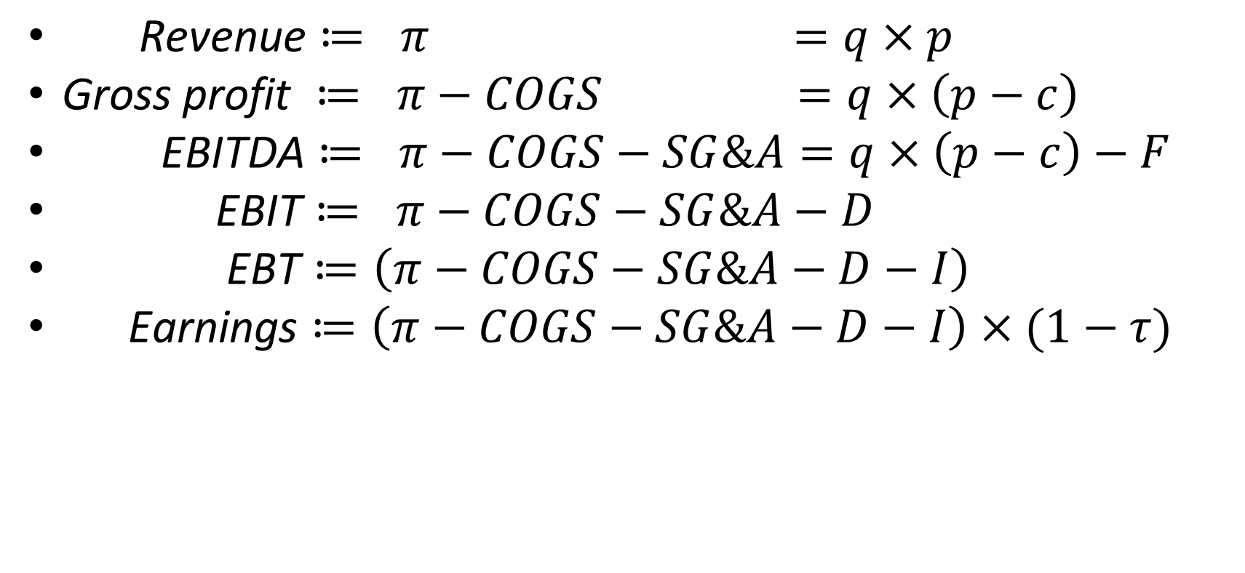
$\text{Revenue}≔ π =q×p$
$\text{Gross} \text{profit} ≔ π−COGS =q×\left(p−c\right)$
$\text{EBITDA}≔ π−COGS−SG\&A=q×\left(p−c\right)−F$
$\text{EBIT}≔ π−COGS−SG\&A−D$
$\text{EBT}≔\left(π−COGS−SG\&A−D−I\right)$
$\text{Earnings}≔\left(π−COGS−SG\&A−D−I\right)×(1−τ)$
Revenue
-COGS
Gross Profit
-SG&A
EBITDA
-Depreciation
EBIT
- Interest Payment
EBT
-Tax
Earnings
Revenue to Earnings
Copyright © 2021 Schuman Associates

Slide 11
Suppose we are trying to judge the value of the house
Capital structure: How does the firm finance itself?
25% Debt
50% Debt
75% Debt
House
House
House
75% Equity
50% Equity
25% Equity
House Analogy
Copyright © 2021 Schuman Associates

Slide 12
Capital structure can be changed
The investor cares about fundamentals (things that cannot be changed)
The investor needs to ignore capital structure
The fundamentals of the business are more important than the short term financing.
The investors problem
Copyright © 2021 Schuman Associates

Slide 13

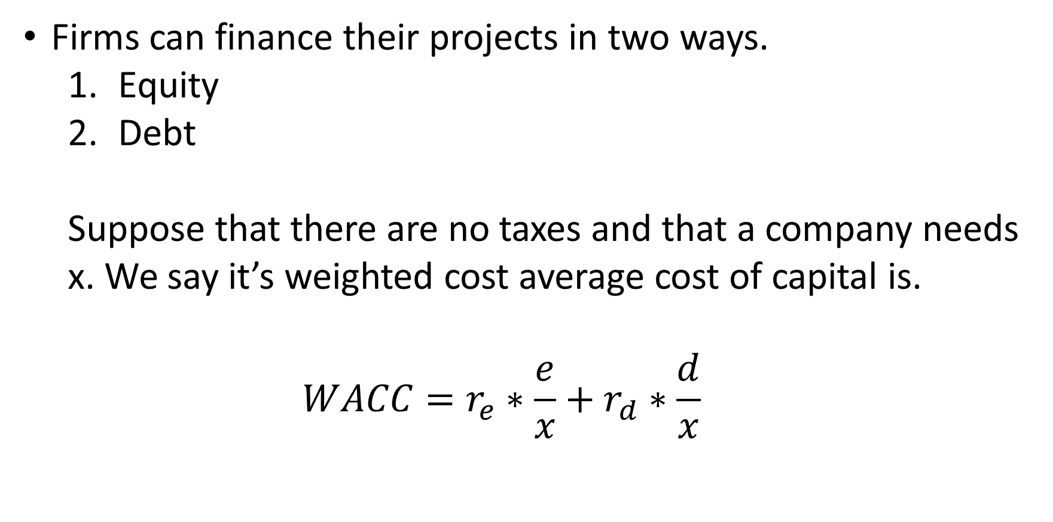
Firms can finance their projects in two ways.
Equity
Debt
Suppose that there are no taxes and that a company needs x. We say it’s weighted cost average cost of capital is.
$$WACC=r_{e}∗\frac{e}{x}+r_{d}∗\frac{d}{x}$$
Capital Structure
Copyright © 2021 Schuman Associates

Slide 14
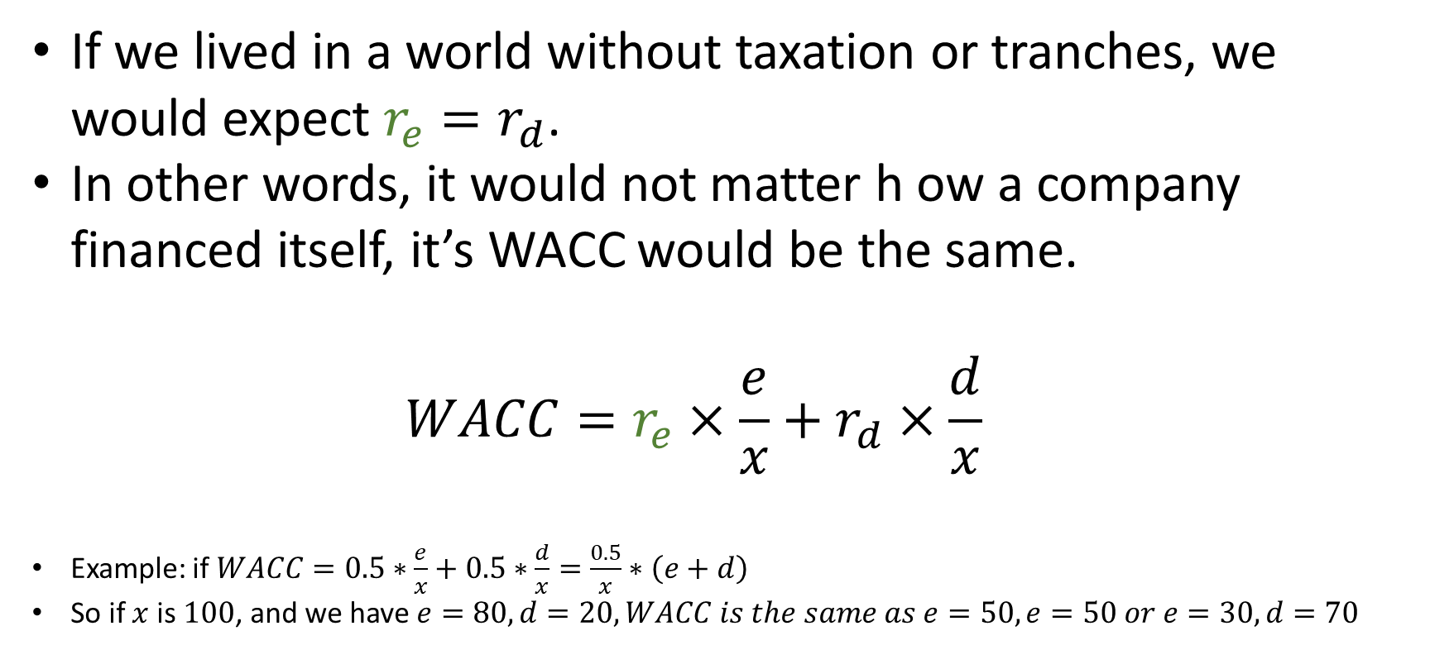
If we lived in a world without taxation or tranches, we would expect $r_{e}=r_{d}$.
In other words, it would not matter h ow a company financed itself, it’s WACC would be the same.
$$WACC=r_{e}×\frac{e}{x}+r_{d}×\frac{d}{x}$$
Example: if $WACC=0.5∗\frac{e}{x}+0.5∗\frac{d}{x}=\frac{0.5}{x}∗\left(e+d\right)$
So if $x$ is $100$, and we have $e=80, d=20, WACC is the same as e=50,e=50 or e=30, d=70$
Capital Structure
Copyright © 2021 Schuman Associates

Slide 15
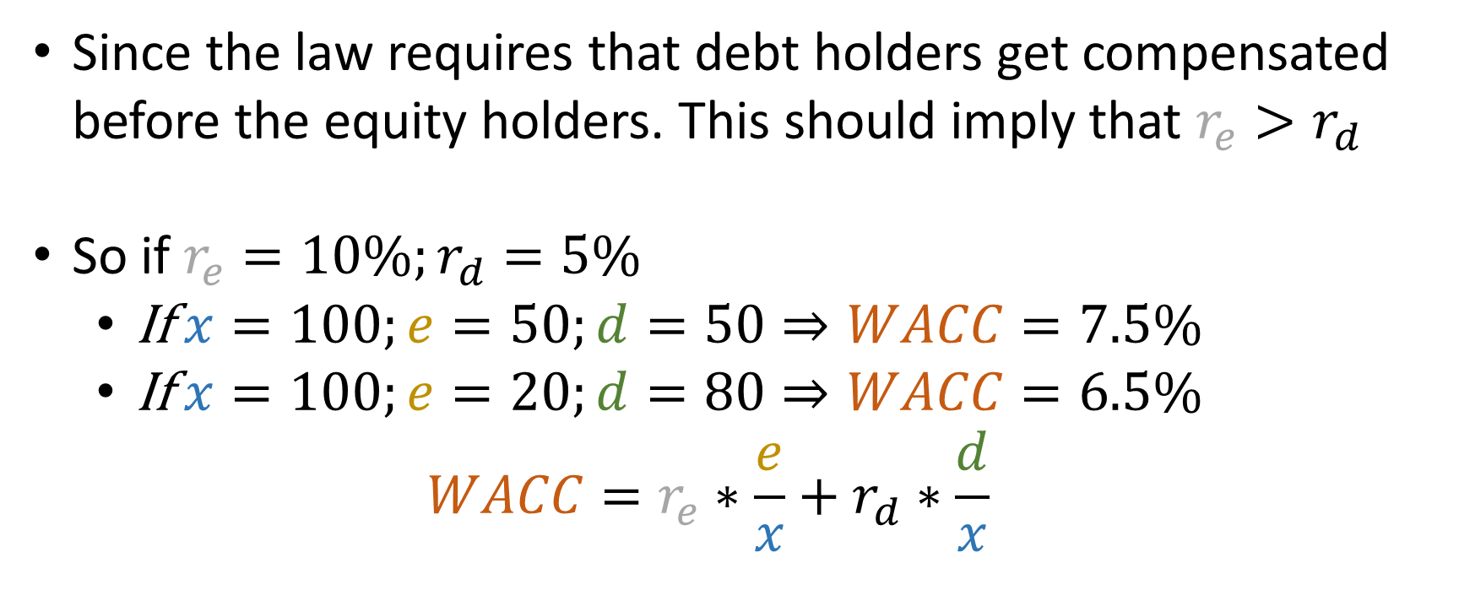
Since the law requires that debt holders get compensated before the equity holders. This should imply that $r_{e}>r_{d}$
So if $r_{e}=10\%;r_{d}=5\%$
If $x=100;e=50;d=50⇒WACC=7.5\%$
If $x=100;e=20;d=80⇒WACC=6.5\%$
$$WACC=r_{e}∗\frac{e}{x}+r_{d}∗\frac{d}{x}$$
Capital Structure with tranching
Copyright © 2021 Schuman Associates

Slide 16
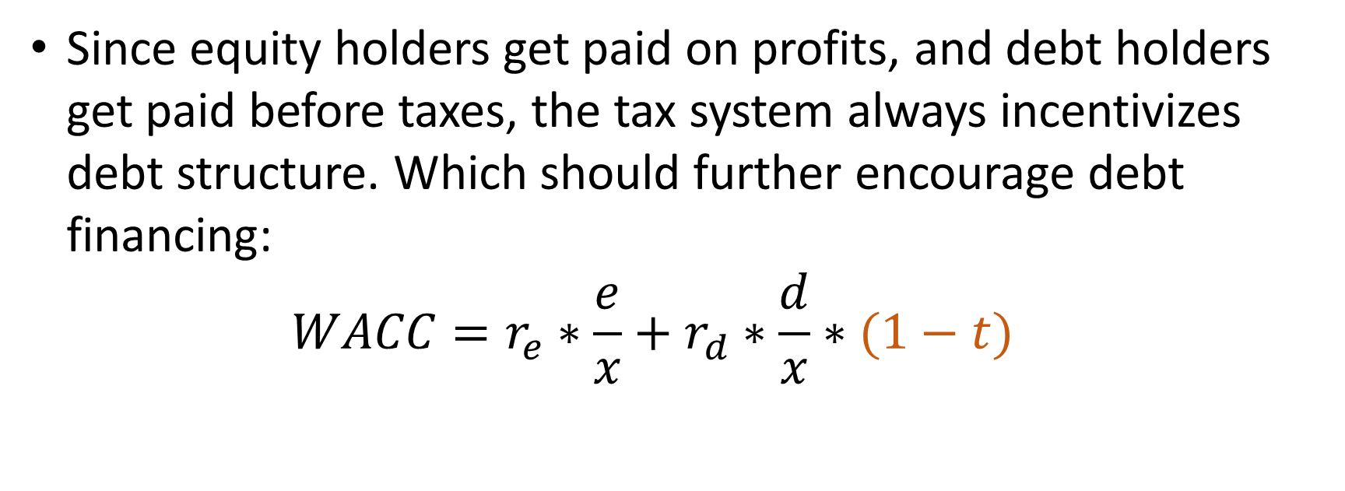
Since equity holders get paid on profits, and debt holders get paid before taxes, the tax system always incentivizes debt structure. Which should further encourage debt financing:
$$WACC=r_{e}∗\frac{e}{x}+r_{d}∗\frac{d}{x}∗(1−t)$$
Capital Structure with taxes
Copyright © 2021 Schuman Associates

Slide 17
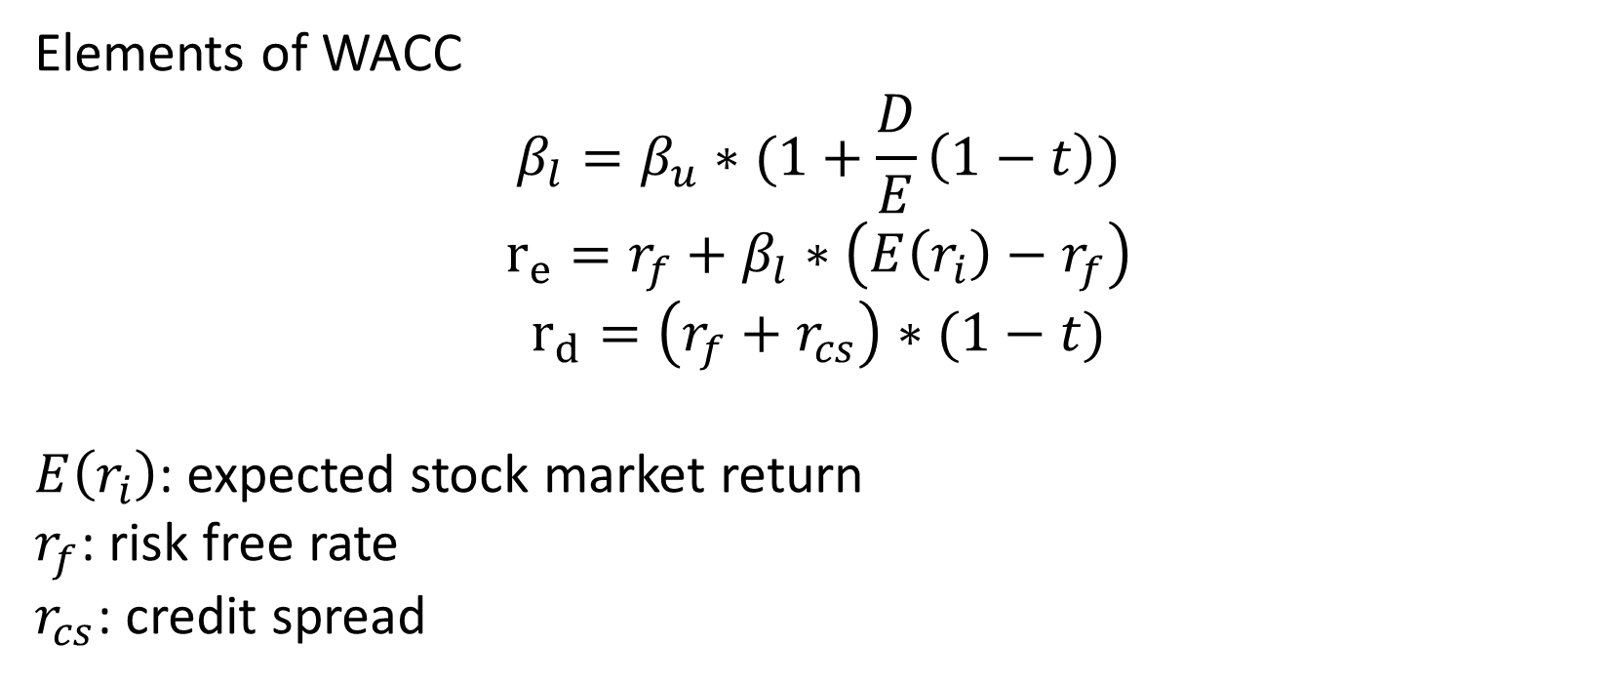
Elements of WACC
$$β_{l}=β_{u}∗(1+\frac{D}{E}\left(1−t\right))$$
$$r_{e}=r_{f}+β_{l}∗\left(E\left(r_{i}\right)−r_{f}\right)$$
$$r_{d}=\left(r_{f}+r_{cs}\right)∗(1−t)$$
$E\left(r_{i}\right)$: expected stock market return
$r_{f}$: risk free rate
$r_{cs}$: credit spread
WACC building blocks
Copyright © 2021 Schuman Associates

Slide 18
Cash flow: Cash from operations = CF
Free cash flow: CF+ Cash from investing = FCF
Free cash flow to equity: FCF + Cash from debt issuance = FCFE
Problems: all these change depending on capital structure, only good for assessing short term
Investor’s solutions
Copyright © 2021 Schuman Associates

Slide 19
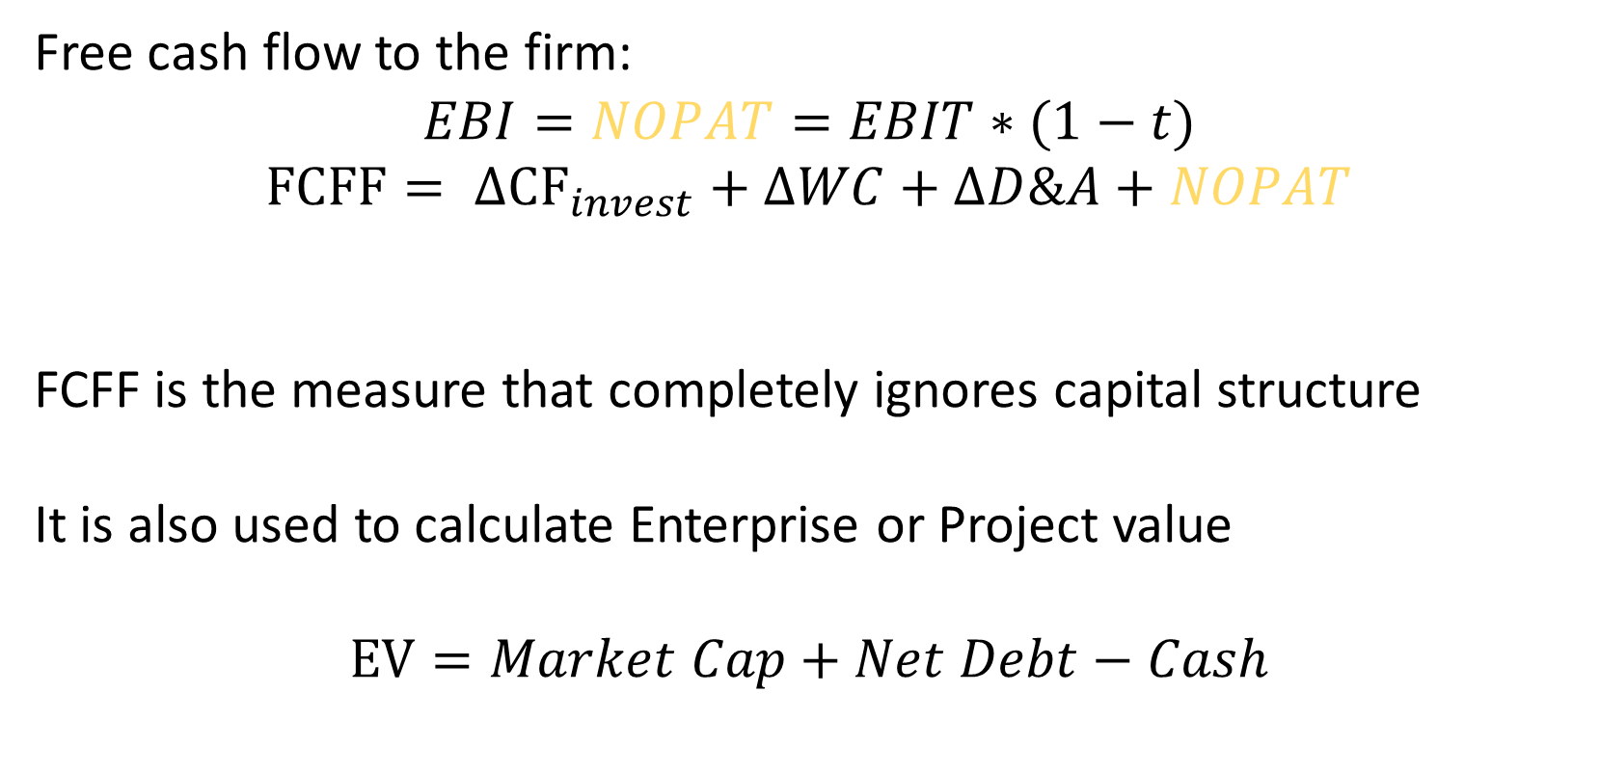
Free cash flow to the firm:
$$EBI=NOPAT=EBIT∗(1−t)$$
$$FCFF= {ΔCF}_{invest}+ΔWC+ΔD\&A+NOPAT$$
FCFF is the measure that completely ignores capital structure
It is also used to calculate Enterprise or Project value
$$EV=Market Cap+Net Debt−Cash$$
Investor’s solutions: FCFF
Copyright © 2021 Schuman Associates

Slide 20
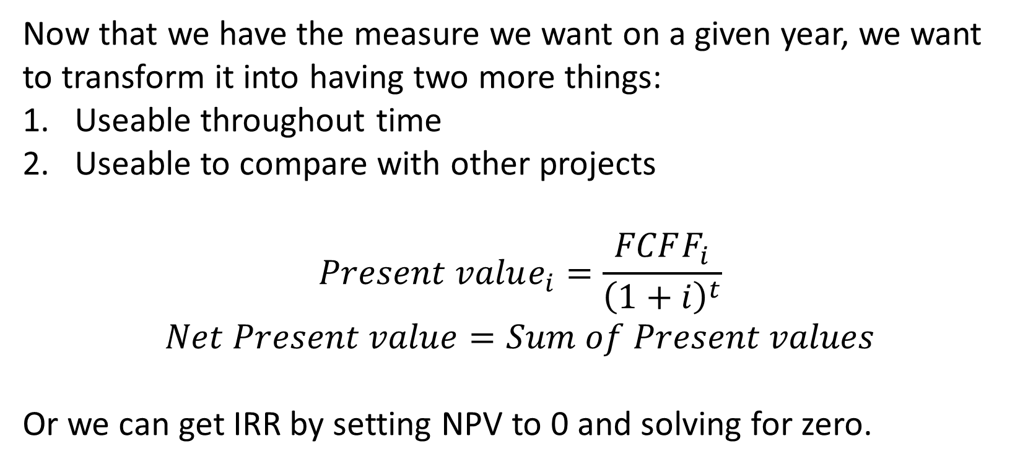
Now that we have the measure we want on a given year, we want to transform it into having two more things:
Useable throughout time
Useable to compare with other projects
$$Present value_{i}=\frac{FCFF_{i}}{{\left(1+i\right)}^{t}}$$
$$Net Present value=Sum of Present values$$
Or we can get IRR by setting NPV to 0 and solving for zero.
From FCFF to NPV
Copyright © 2021 Schuman Associates

Slide 21
Requirements
Projects can either be launched or aborted, no delay is possible
Total NPV of all project combinations considered
Reasonably good forecast of interest rates/WACC
Unbiased estimate of cash inflows
Non requirements:
Investment is up front
Interest rate is constant
Cash flow follows some pattern
Assumptions of NPV
Copyright © 2021 Schuman Associates

Slide 22
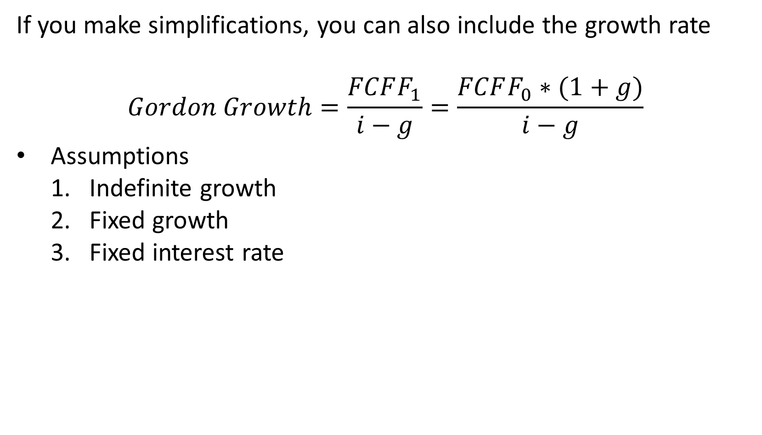
If you make simplifications, you can also include the growth rate
$$Gordon Growth=\frac{FCFF_{1}}{i−g}=\frac{FCFF_{0}∗(1+g)}{i−g}$$
Assumptions
Indefinite growth
Fixed growth
Fixed interest rate
Using FCFF
Copyright © 2021 Schuman Associates

Slide 23
Motivation:
Different time distributions of income(-1,3)(-2,4)(1,1)
Only the long term profitability ought to matter
Policy ought to make the distribution of income irrelevant
Carry forward of losses: Your past losses can be deducted from your future gains to reduce future tax
Carrybacks: Past taxes can be reclaimed to offset present losses.
Carry Forward and Carrybacks
Copyright © 2021 Schuman Associates

Slide 24
Country | Loss Carryback(years) | Loss Carryforward(years) | Additional Comments
Austria | COVID: Carry back up to 5million | NL; 75% of Taxable over 1m
Belgium | COVID: 13/03/2019-31/07/2020 | NL; 70% of Taxable over 1m
Czech Republic | 2y up to CZK 30 million | 5
Denmark | 0 | NL; 60% of Taxable over DKK 8,767,500
Estonia/Latvia | NL | NL
Finland | 0 | 10
France | 1y up to 1m | NL; 50% of taxable income over 1m
Germany | 1y up to 10m | NL; 60% of taxable income over 1m
Greece | 0 | 5
Hungary | 0 | 5; 50% of taxable income
Ireland | 1 | NL | Trading/Non-trading
Italy | 0 | NL; 80% of taxable | 100% for first 3 years
Lithuania | 0 | NL; 70% of taxable
Luxembourg | 0 | 17
Netherlands | 1 | 6
Carry Forward and Carrybacks
Copyright © 2021 Schuman Associates

Slide 25
Country | Loss Carryback(years) | Loss Carryforward(years) | Additional Comments
Norway | 0 | NL
Poland | 0 | 5; 50% of Taxable
Portugal | 0 | 12; 80% of Taxable | SME’s up to 100%
Slovak Republic | 0 | 5; 50% of Taxable | No cap below 100k
Slovenia | 0 | NL; 63% of Taxable
Spain | 0 | NL; 70% of Taxable over 1m
Sweden | 1.5 | NL
Switzerland | 0 | 7
United Kingdom | 1 | NL; 50% of Taxable over 5m GBP
https://taxfoundation.org/net-operating-loss-policies-oecd/
Carry Forward and Carrybacks
Copyright © 2021 Schuman Associates

Slide 26




Thank you for listening
Stay in touch
0032 (0) 22 307 439
info@schumanassociates.com
www.schumanassociates.com
Rue Archimède 5, bte 12, B-1000 Brussels, Belgium
Credits
Icons from www.flaticon.com:
“Our engagement model” slide: “lightbulb” and “networking” by Freepik; “strategy” 1 by smalllikeart; “strategy” 2 by Becris.
“Sectors” slide: “coal”, “computer”, “museum” and “power-button” by Freepik; “cardiogram” by Anatoly; “diagram” by Pause08; “green-energy” by Good Ware; “science” by itim2101; “work-team” by turkkub.
“An integrated approach” slide: “promotion” and “museum” by Freepik; “deal” by Those Icons.
Copyright © 2021 Schuman Associates

